Slide 1



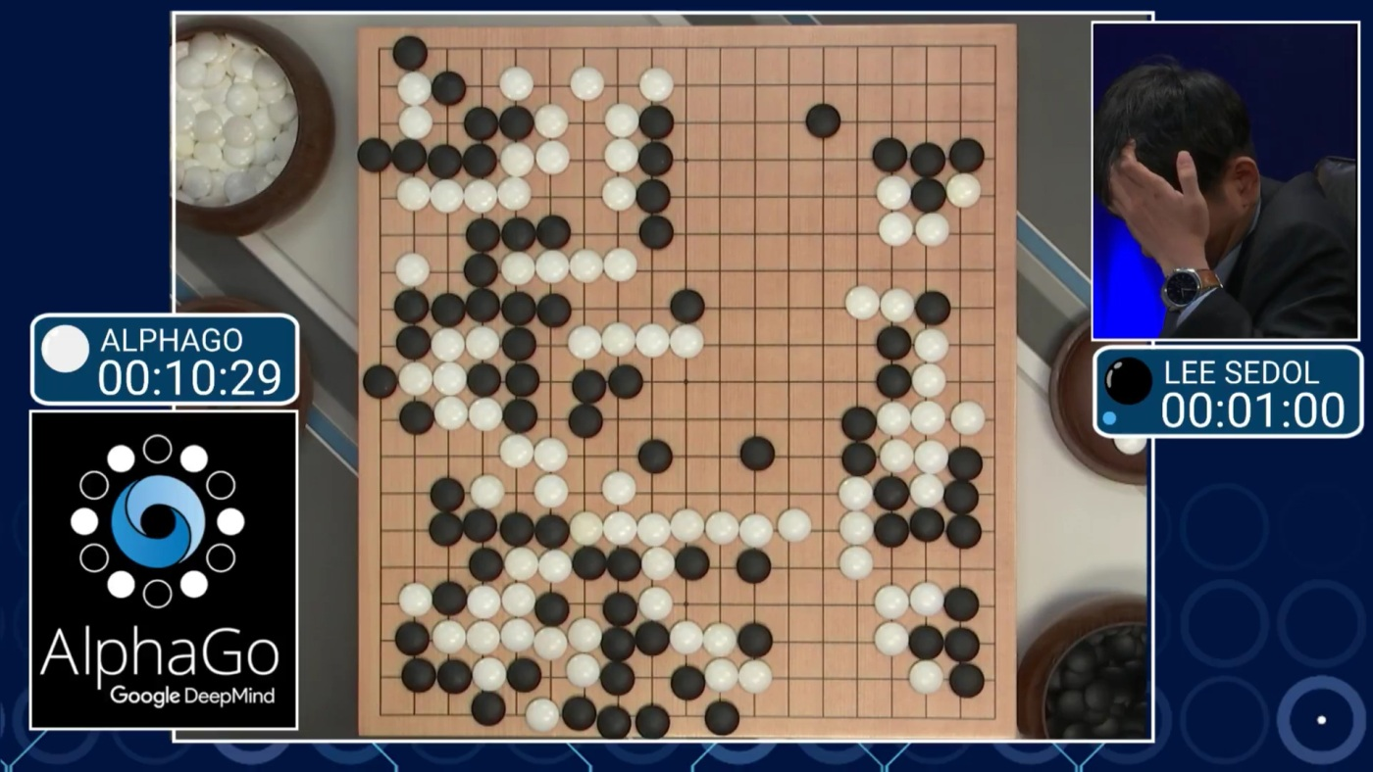

Slide 2
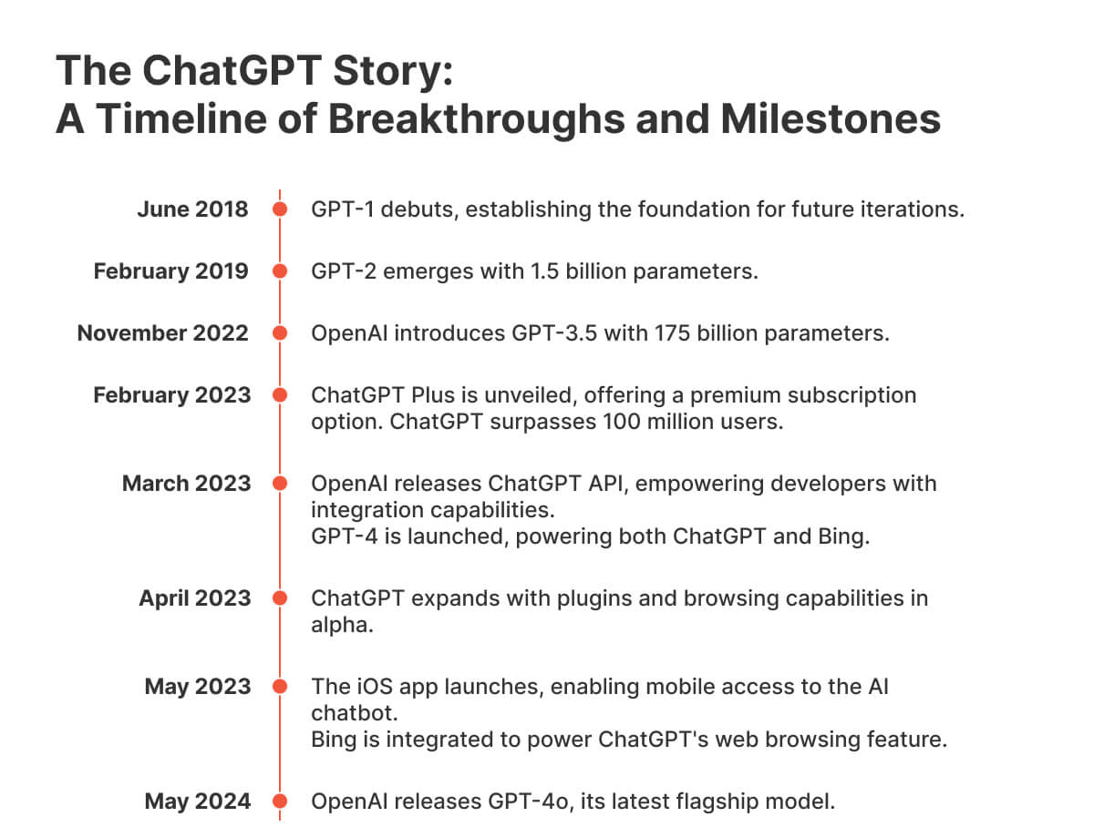


Slide 3
What will you learn?
What is AI and where do LLMs fit in the AI landscape
Basic intuition of LLMs work
Common pitfalls of using LLMs and why they happen

Slide 4
LLM model architecture
Common steps of a basic LLM
Generating useful outputs from a trained LLM
Let’s build an LLM from scratch!
Common pitfalls of using LLMs

Slide 5


Slide 6
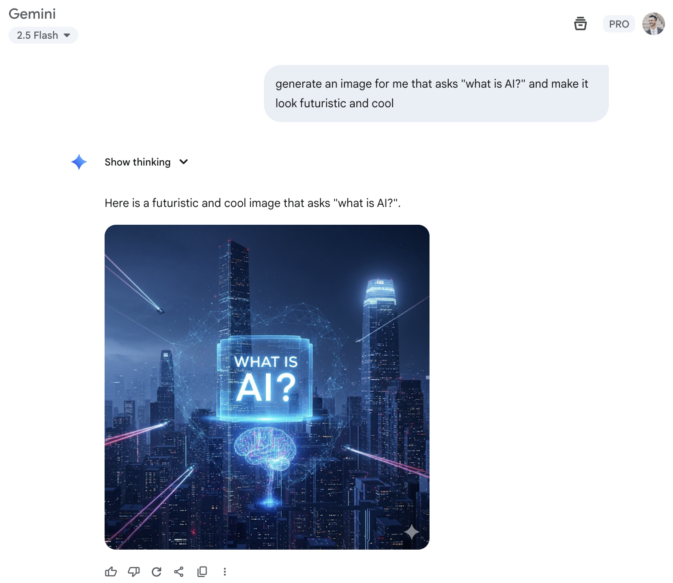

Slide 7
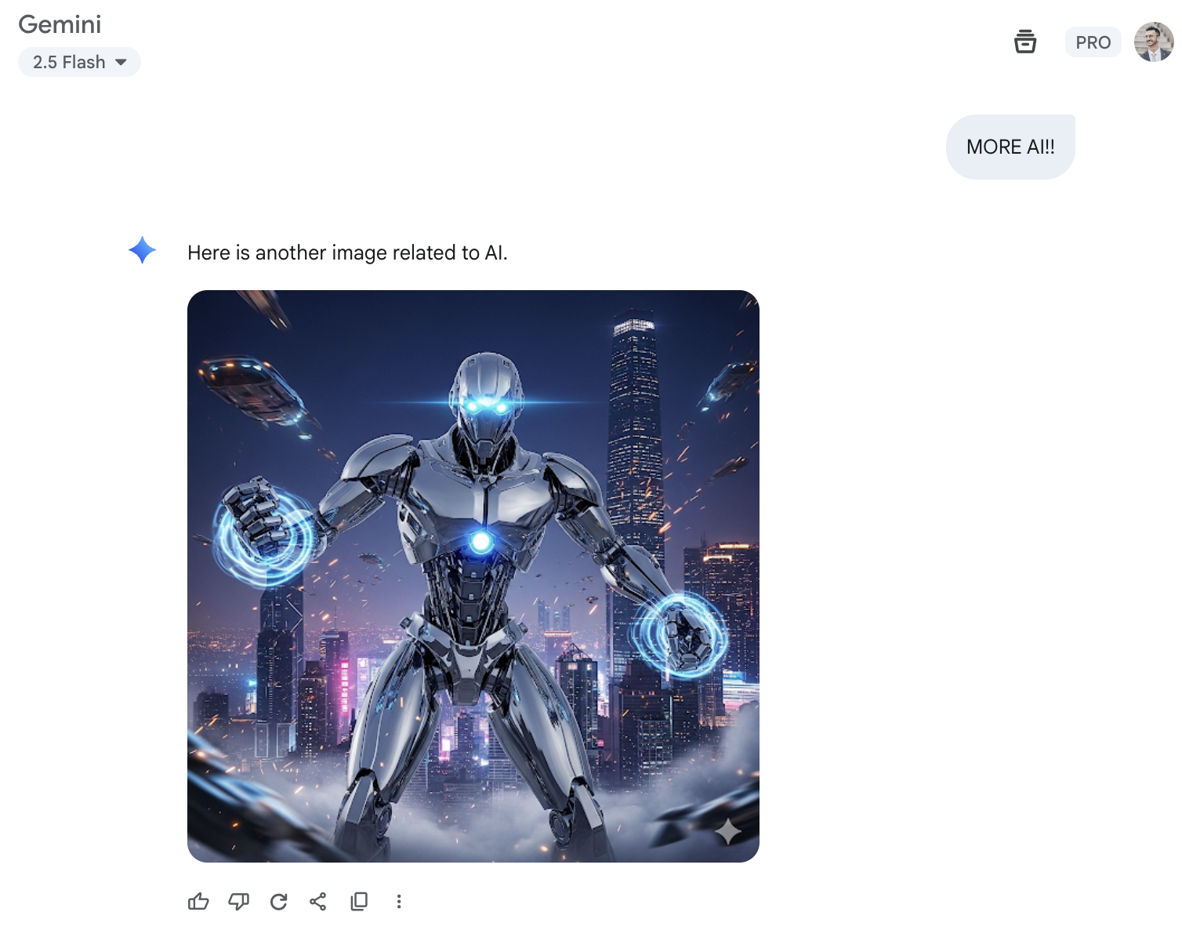
Notes:
This is what life would look like if you all just listen to Mari and restart your PCs every week
What have we learnt from this: ai is dark background, and lots of dark blue and purple

Slide 8
a

Slide 9
a

Slide 10
a

Slide 11
a

Slide 12
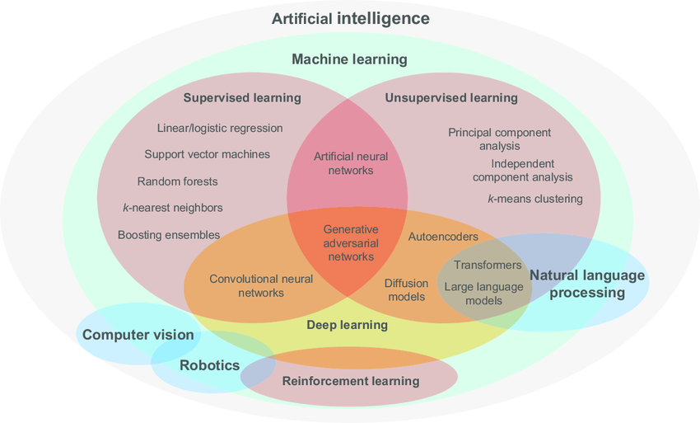

Slide 13
